Slide 1

Principal Component Analysis
(PCA)
A Dimensionality Reduction Method
Prepared By:
Apurv Vidhate (2183046)
MITU18BTCS0267
Final Year CSE Core

Slide 2
What is Dimensionality Reduction?
Wikipedia says, Dimensionality reduction, or dimension reduction, is the transformation of data from a high-dimensional space into a low-dimensional space so that the low-dimensional representation retains some meaningful properties of the original data, ideally close to its intrinsic dimension.
In Simple words, we can say that Dimensionality Reduction is a technique where we convert a high dimension dataset into a lesser dimension dataset while still ensuring that it provides similar information.
Prepared By Apurv Vidhate

Slide 3
Principal Component Analysis (PCA)
Principal Component Analysis, or PCA, is a dimensionality-reduction method that is often used to reduce the dimensionality of large data sets, by transforming a large set of variables into a smaller one that still contains most of the information in the large set.
But, Reducing the number of variables of a data set naturally comes at the expense of accuracy. The trick in dimensionality reduction is to trade a little accuracy for simplicity. As smaller data sets are easier to explore and visualize and make analyzing data much easier and faster for machine learning algorithms without extraneous variables to process.
Prepared By Apurv Vidhate

Slide 4
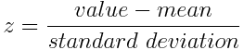
Steps in Principal Component Analysis (PCA)
STEP 1: STANDARDIZATION
The aim of this step is to standardize the range of the continuous initial variables so that each one of them contributes equally to the analysis.
Mathematically, this can be done by subtracting the mean and dividing by the standard deviation for each value of each variable.
Once the standardization is done, all the variables will be transformed to the same scale.
Prepared By Apurv Vidhate

Slide 5
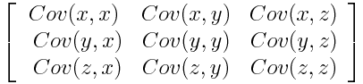
STEP 2: COVARIANCE MATRIX COMPUTATION
The aim of this step is to understand how the variables of the input data set are varying from the mean with respect to each other, or in other words, to see if there is any relationship between them. Because sometimes, variables are highly correlated in such a way that they contain redundant information. So, in order to identify these correlations, we compute the covariance matrix.
The covariance matrix is a p × p symmetric matrix (where p is the number of dimensions) that has as entries the covariances associated with all possible pairs of the initial variables.
Prepared By Apurv Vidhate

Slide 6
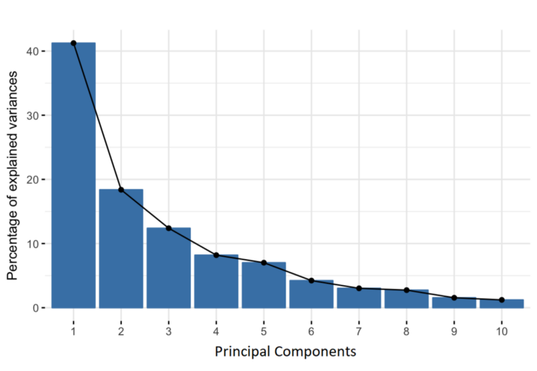
STEP 3: COMPUTE THE EIGENVECTORS AND EIGENVALUES
Eigenvectors and eigenvalues are the linear algebra concepts that we need to compute from the covariance matrix in order to determine the principal components of the data.
Principal components are new variables that are constructed as linear combinations or mixtures of the initial variables. These combinations are done in such a way that the new variables (i.e., principal components) are uncorrelated and most of the information within the initial variables is squeezed or compressed into the first components.
Prepared By Apurv Vidhate

Slide 7
Step 3 (Cont.)
Organizing information in principal components this way, will allow you to reduce dimensionality without losing much information, and this by discarding the components with low information and considering the remaining components as your new variables.
Geometrically speaking, principal components represent the directions of the data that explain a maximal amount of variance, that is to say, the lines that capture most information of the data.
Prepared By Apurv Vidhate

Slide 8
STEP 4: FEATURE VECTOR
As we saw in the previous step, computing the eigenvectors and ordering them by their eigenvalues in descending order, allow us to find the principal components in order of significance. In this step, what we do is, to choose whether to keep all these components or discard those of lesser significance (of low eigenvalues), and form with the remaining ones a matrix of vectors that we call Feature vector.
So, the feature vector is simply a matrix that has as columns the eigenvectors of the components that we decide to keep. This makes it the first step towards dimensionality reduction, because if we choose to keep only p eigenvectors (components) out of n, the final data set will have only p dimensions.
Prepared By Apurv Vidhate

Slide 9

LAST STEP: RECAST THE DATA
In the previous steps, apart from standardization, you do not make any changes on the data, you just select the principal components and form the feature vector, but the input data set remains always in terms of the original axes (i.e, in terms of the initial variables).
In this step, which is the last one, the aim is to use the feature vector formed using the eigenvectors of the covariance matrix, to reorient the data from the original axes to the ones represented by the principal components (hence the name Principal Components Analysis). This can be done by multiplying the transpose of the original data set by the transpose of the feature vector.
Prepared By Apurv Vidhate

Slide 10
So to sum up, the idea of PCA is simple — reduce the number of variables of a data set, while preserving as much information as possible.
Prepared By Apurv Vidhate

Slide 11
Thank you
Prepared By:
Apurv Vidhate (2183046)
MITU18BTCS0267
Final Year CSE Core

